Slide 1
Towards Validity-Weighted Attenuation of Affective Noise in Student Evaluations of Teaching
An auditable ABSA framework that adjusts SET ratings by down-weighting construct-irrelevant emotion.
17,121 RateMyProfessors Reviews

Slide 2
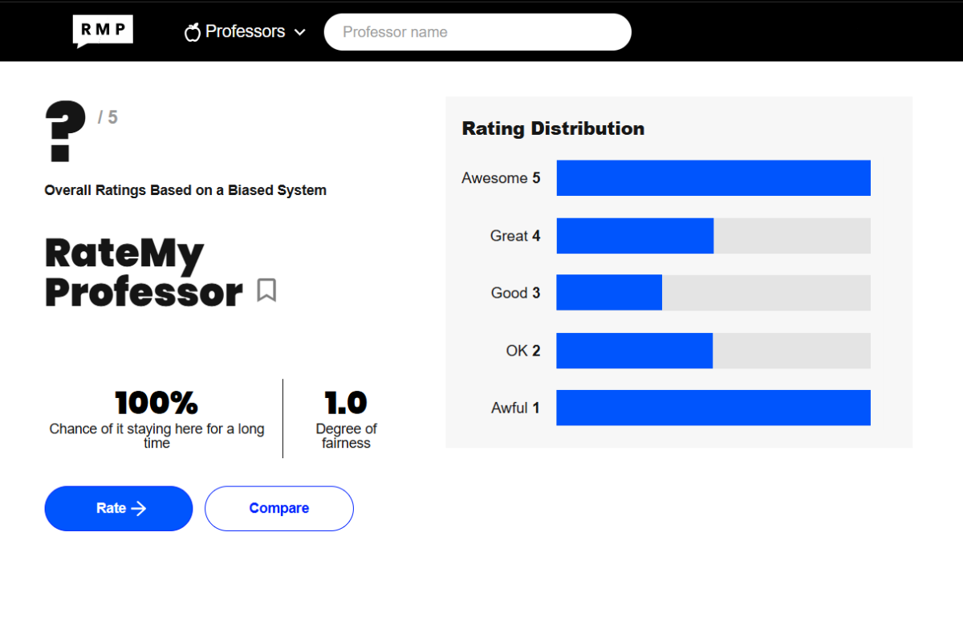

Slide 3
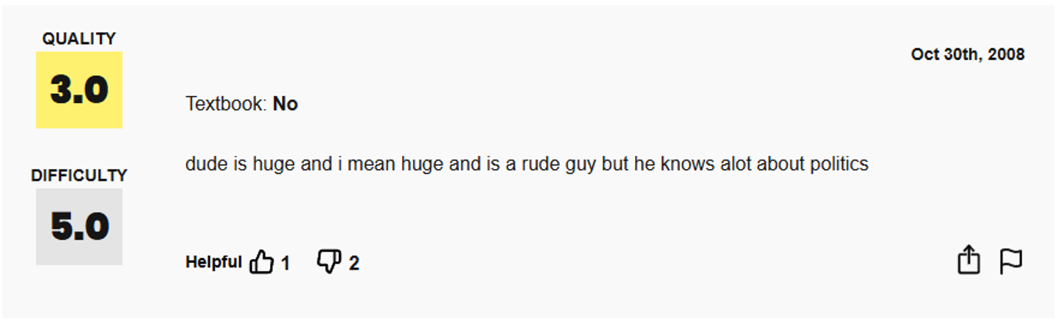

Slide 4
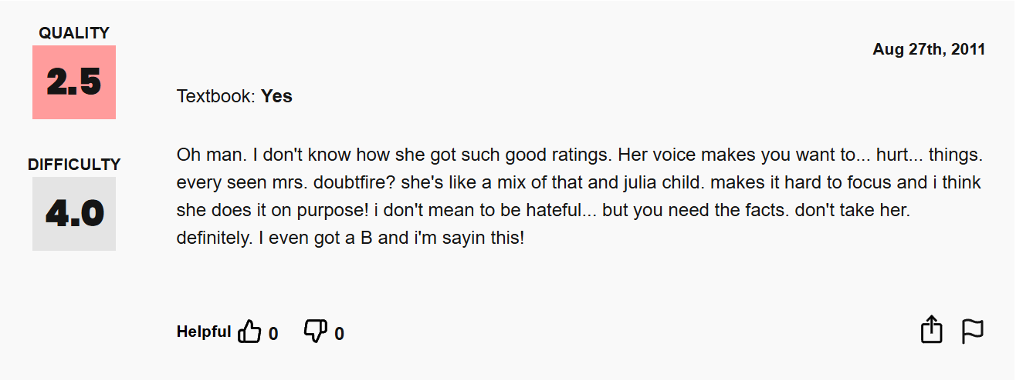

Slide 5
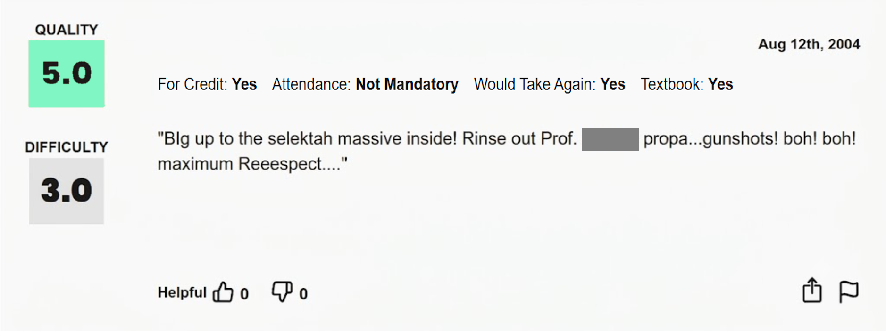

Slide 6
What are we actually measuring?

Slide 7
Scores averaged across an ill-defined assortment of items offer no basis for knowing what is being measured.
Marsh & Roche — American Psychologist, 1997 · p. 1187

Slide 8
Wongsurawat (2011) — "white noise": pedagogically irrelevant content is a source of measurement error; low-correlation comments should be discounted

Slide 9
Schiekirka & Raupach (2015) — student characteristics, performance level and evaluation process act as confounders on ratings

Slide 10
Li et al. (2025) — emotional interaction with the instructor leads students to overlook actual teaching quality

Slide 11
Three literatures, one finding
Student ratings respond to content that has nothing to do with teaching — irrelevant commentary, situational confounders, and emotional response to the instructor.
These influences are systematic, not random — so averaging across students does not remove them.
On RateMyProfessors, nothing constrains what students write.

Slide 12
Possible Solutions
Constrain the Instrument | Discard bad reviews | Down-weight by content
Narrow, targeted items | Filter “low quality” comments | Keep every review, but reduce the influence of irrelevant content.
Removes noise by construction | Removes noise by exclusion | Attenuates noise, while aiming to preserve signal.
Cost: Loses the expressiveness that makes open ended feedback worth collecting; can’t be applied to existing data. | Cost: Discards signal along with noise. Who decides what’s “bad” | Bounded, auditable, contextual to each review.
Notes:
Down-weighting rather than discarding isn't a new idea — it's the standard result in robust estimation.

Slide 13
Down-weighting is the principled choice
Huber (1964) — robust estimation: bounded-influence weighting yields more stable, less biased estimates than deletion. Discarding an observation is just a weight of 0 — the crudest possible choice.
Cronbach (1951) — measurement quality improves by reducing error variance, not by removing observations.
Marsh & Roche (1997) — corrections that ignore valid variance risk "throwing the validity baby out with the bias bathwater."

Slide 14
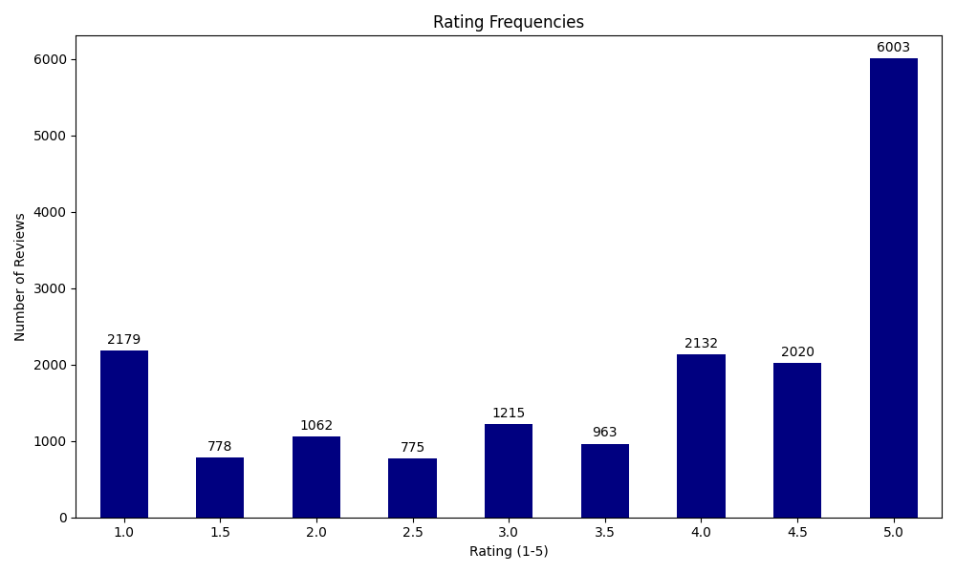
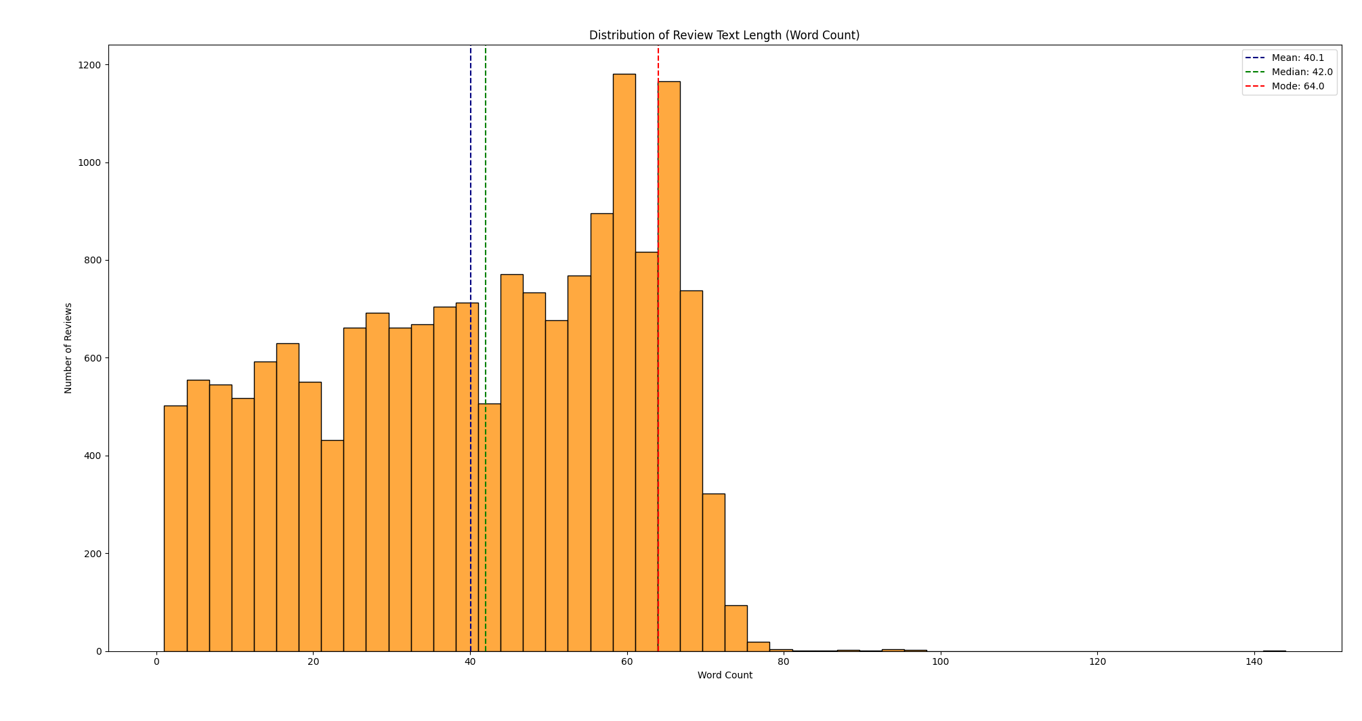
The corpus
17,121 RateMyProfessors reviews
1,029 professors · open-source dataset (He, 2020) · rating 1–5 + free text
Mean review length 40.1 words (SD 20.3) — short, informal, unstructured
Ratings are negatively skewed: 5-star reviews dominate
RMP prohibits scraping; permission was requested and not granted. No data was collected directly from the site.

Slide 15
Research Questions
RQ1 — How does emotional content in pedagogical comments contribute to SET ratings?
RQ2 — To what extent does emotional content in pedagogically irrelevant comments contribute to SET ratings?
RQ3 — Can emotional attenuation of irrelevant comments mitigate affective noise while preserving pedagogical signal?

Slide 16
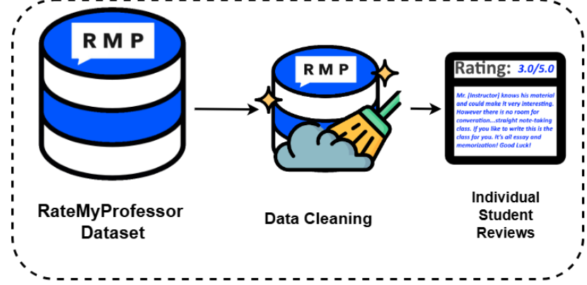

Slide 17
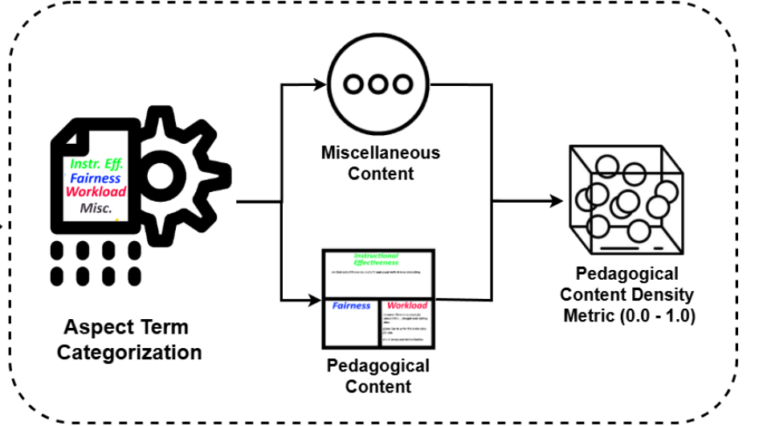

Slide 18
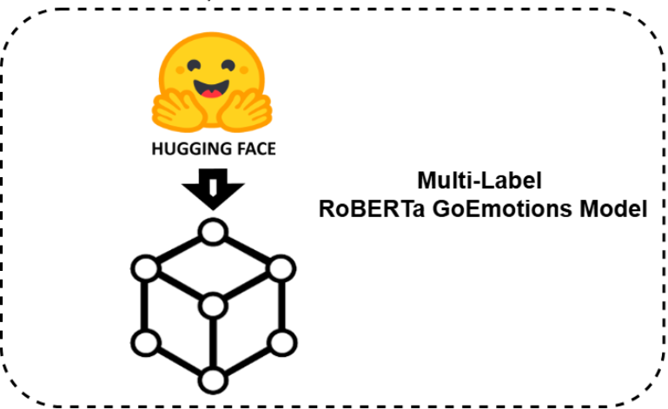

Slide 19
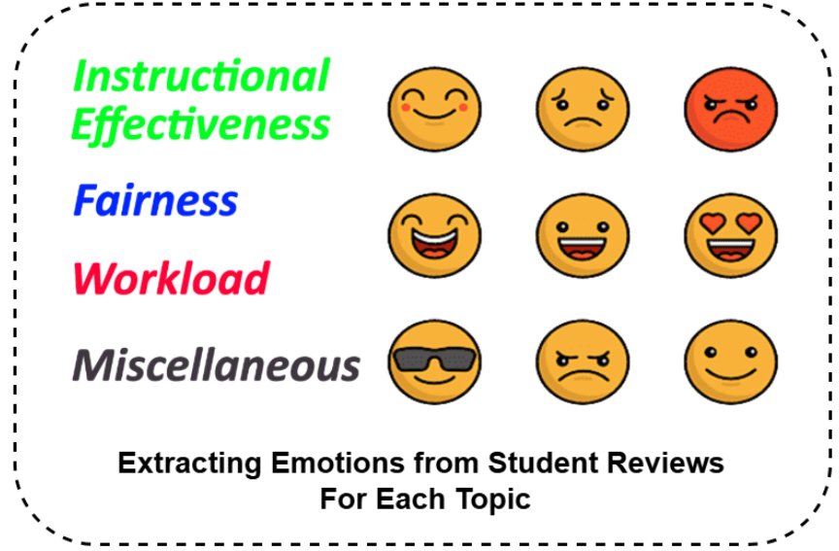

Slide 20
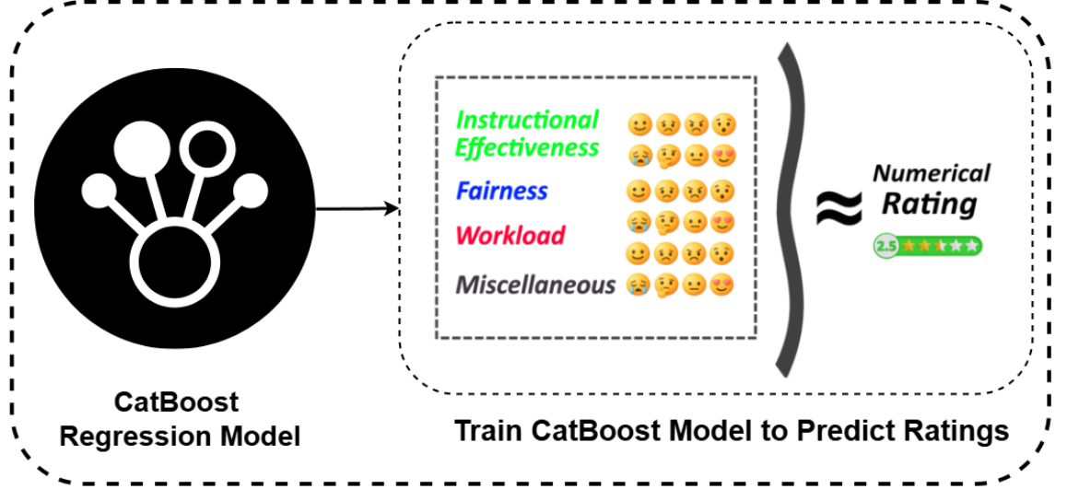

Slide 21
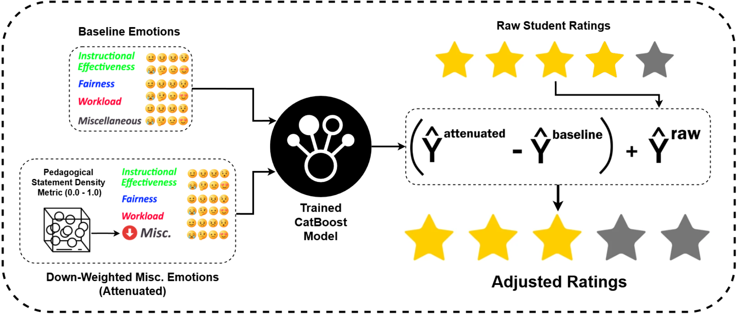

Slide 22
In Greater Detail
ATC (Aspect-Term Categorization)
Sentiment Extraction
CatBoost Modeling
Validity-weighted Attenuation and Rating Adjustment

Slide 23
ATC
Review Clauses are embedded using all-mpnet-base-v2
Category Descriptions are embedded
Cosine Similarity compares the semantic “distance” between the categories and each review clause
Assign the highest-similarity category if its cosine similarity exceeds 0.25
Otherwise assign Miscellaneous.
Miscellaneous, Instructional Effectiveness, Workload, Fairnes

Slide 24
Miscellaneous Density
The proportion of the overall review directed towards the misc category.
Represents how on-topic a review is.
D_misc = 1.0 -> fully off-topic
D_misc = 0 -> fully on-topic

Slide 25
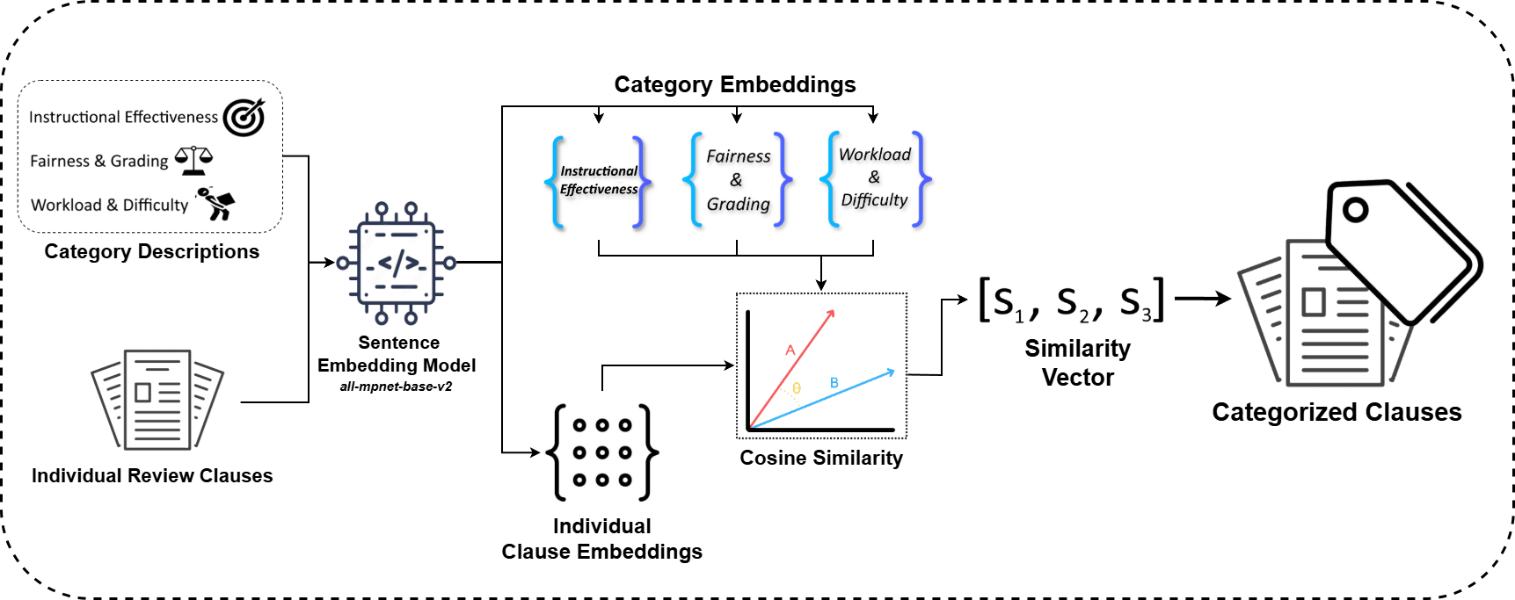

Slide 26
Sentiment Extraction
Categorized clauses are individually fed into roberta-base-go_emotions
Model trained from roberta-base on the go_emotions dataset (reddit comments) for multi-label classification.
Outputs a 28-dimensional emotional probability vector.
INT8 quantized ONNX model was used.

Slide 27
Feature Aggregation per Review
4 Categories – each with with 27 features
Reviews can contain multiple different categories of clauses.
How to obtain a single feature vector per review?
Combine all categories into one vector across a review’s clauses
Average out emotional contributions directed towards the same category
Impute 0’s if the category was not mentioned.

Slide 28
Feature Aggregation Cont.
Final feature vector per review = 27 x 4 + (D_misc, D_eff, D_work, D_fair) = 112 features
D_misc = Miscellaneous density
D_eff = Intructional Effectiveness density
etc.

Slide 29
CatBoost Modeling
A gradient boosted tree-based modeling library. Can be used for categorical or numerical data (regression).
Highly effective for sparse data (remember the imputed 0’s) and non-linear data.
Ratings are modeled as a function of their categorical emotional features (+ densities).
Professor-level grouped split and 5-fold CV.
Model is saved after training.
Baseline predictions are also preserved.

Slide 30
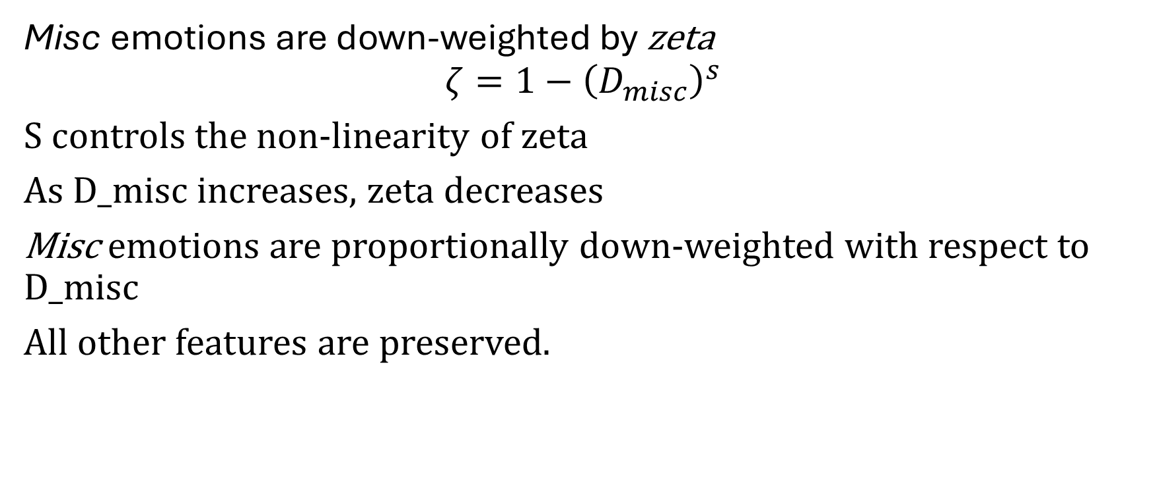
Validity-Weighted Attenuation
Misc emotions are down-weighted by zeta
$$ζ=1−{\left(D_{misc}\right)}^{s}$$
S controls the non-linearity of zeta
As D_misc increases, zeta decreases
Misc emotions are proportionally down-weighted with respect to D_misc
All other features are preserved.

Slide 31
Validity-Weighted Attenuation Cont.
This “attenuated” feature vector is put back into the CatBoost model which predicts a new rating.
Take the difference of the baseline prediction and attenuated prediction.
Remove the model-estimated contribution of the down-weighted Misc emotion from the original student rating.
Ta Da!

